Slide 1
Air Pure Innovations Annual Report
"Arise, awake, and stop not until the goal is reached.“
-Swami Vivekananda

Slide 2
Table of contents
01
02
03
Problem statement
Primary Analysis
Secondary
Analysis

Slide 3
01
Problem
Statement

Slide 4
Problem Statement:-
Company: Air Pure Innovations, an Indian startup.
Problem: The company needs to determine if there is a strong and sustained market demand for a new air purifier before investing in product development and production.
My Role: As data analyst Peter Pandey, I am tasked with analyzing air quality (AQI), health, and other datasets to guide strategic decisions.
Key Objectives:
Severity Mapping: Identify the Indian cities with the most severe and persistent air pollution.
Health Impact: Quantify the link between poor air quality and negative health outcomes to understand the impact on consumer well-being.
Demand Triggers: Analyze what causes spikes in consumer interest and demand for air purifiers
.
Ultimate Goal: To deliver a data-driven recommendation on which cities to target, what essential features the product must have, and which specific pollutants it should filter, all presented in a clear dashboard for the management team.

Slide 5
02
Primary
Analysis

Slide 6
Primary analysis questions:-
List the top 5 and bottom 5 areas with highest average AQI. (Consider areas which contains data from last 6 months: December 2024 to May 2025)
2. List out top 2 and bottom 2 prominent pollutants for each state of southern India. (Consider data post covid: 2022 onwards)
3. Does AQI improve on weekends vs weekdays in Indian metro cities (Delhi, Mumbai, Chennai, Kolkata, Bengaluru, Hyderabad, Ahmedabad, Pune)? (Consider data from last 1 year)
List the top 5 states with high EV adoption and analyse if their average AQI is significantly better compared to states with lower EV adoption
Which months consistently show the worst air quality across Indian states — (Consider top 10 states with high distinct areas)
For the city of Bengaluru, how many days fell under each air quality category (e.g., Good, Moderate, Poor, etc.) between March and May 2025?
List the top two most reported disease illnesses in each state over the past three years, along with the corresponding average Air Quality Index (AQI) for that period.

Slide 7
03
Secondary
Analysis

Slide 8
Secondary analysis questions:-
Which age group is most affected by air pollution-related health outcomes — and how does this vary by city?
Who are the major competitors in the Indian air purifier market, and what are their key differentiators (e.g., price, filtration stages, smart features)?
What is the relationship between a city’s population size and its average AQI — do larger cities always suffer from worse air quality? (Consider 2024 population and AQI data for this)
How aware are Indian citizens of what AQI (Air Quality Index) means — and do they understand its health implications?
Which pollution control policies introduced by the Indian government in the past 5 years have had the most measurable impact on improving air quality — and how have these impacts varied across regions or cities?

Slide 9
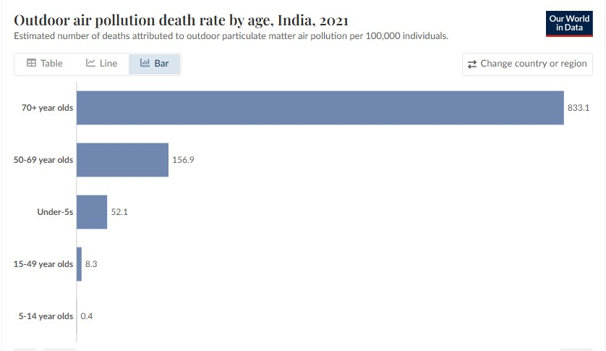
Which age group is most affected by air pollution-related health outcomes:-

Slide 10
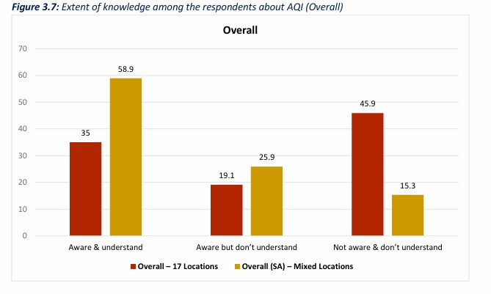
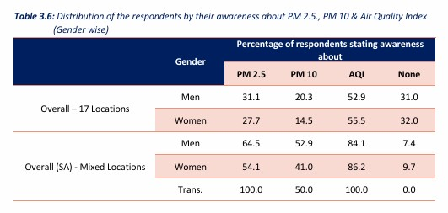
Public Understanding of Air Pollution's Health Implications

Slide 11
National Clean Air Programme (NCAP) - Launched 2019
Measurable Impact:
Widespread Improvement: 95 out of the 131 targeted cities have shown an overall improvement in air quality and a reduction in PM10 levels.
Significant City-Level Success: It has been highly effective in some cities that targeted their specific local pollution sources. Standout examples include:
Dhanbad (Eastern India): Achieved a remarkable 81% reduction in PM10.
Varanasi (Northern India): Saw a significant 68% reduction in PM10.
Limitations & Regional Variation:
Limited Impact in Megacities: Progress has been minimal in deeply polluted, complex urban areas like Delhi (Northern India), which has only seen a ~14% reduction.
Standards Still Not Met: Despite progress, only a small fraction of cities (14 out of 131) currently meet the national safety standards (NAAQS).
Southern India: This region has responded best to the policies, with many cities showing consistent improvement and meeting the standards.

Slide 12
Bharat Stage VI (BS-VI) Norms - Implemented April 2020
Measurable Impact:
Fundamentally Cleaner Fuel: The policy mandated an 80% reduction in sulfur in diesel and petrol, a major source of PM2.5.
Reduced Harmful Emissions: BS-VI technology has successfully cut emissions of key pollutants from new vehicles, including Organic Carbon (-20%) and Carbon Monoxide (-7%).
Universal Impact: Since this is a nationwide standard, every new vehicle sold in every city and region since April 2020 is significantly less polluting than older models.
Limitations & Regional Variation:
Unintended Consequence: The technology has inadvertently caused an increase in harmful Nitrogen Oxides (NOx), a key component of smog, which affects all regions.
Slow Fleet Turnover: The benefits are only from new vehicles. The large number of older, more polluting vehicles still on the roads means the overall improvement to air quality is gradual and will take many more years to be fully realized across all cities.

